Slide 1


Slide 2


Slide 3
As the blocks disappear
Say what you see….

Slide 4


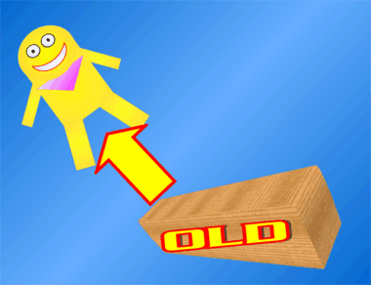

Slide 5
Chip off the old block

Slide 6
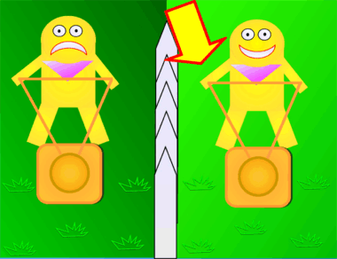

Slide 7
The grass is always greener on the other side

Slide 8


Slide 9
Every cloud has a silver lining

Slide 10
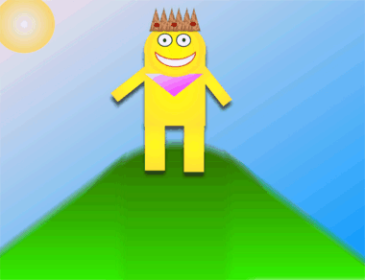

Slide 11
King of the hill

Slide 12


Slide 13
Blast from the past

Slide 14


Slide 15
Bad hair day

Slide 16
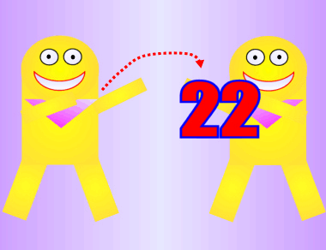

Slide 17
Catch 22

Slide 18
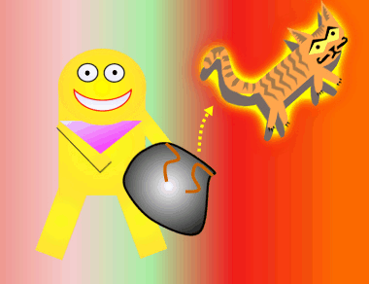

Slide 19
Cat out of the bag

Slide 20


Slide 21
Falling from grace

Slide 22


Slide 23
Hand in hand

Slide 24


Slide 25
Keep an eye on things

Slide 26


Slide 27
Put your money where your mouth is

Slide 28


Slide 29
Split Second

Slide 30


Slide 31
Digging a hole for yourself

Slide 32


Slide 33
Keep it under your hat

Slide 34


Slide 35
Cost an arm and a leg

Slide 36


Slide 37
Going round in circles

Slide 38
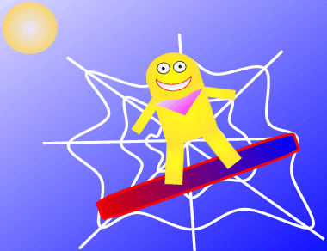

Slide 39
Surf the web

Slide 40
That’s all for now.
Thanks for playing.

